Slide 1

Code Refactoring and Bug Fixing

Slide 2
About me
I’m Sathvika Pulichintha, I have completed my Bachelor’s Degree from Methodist College of Engineering and Technology in Specialization of Computer Science . During my undergraduate studies, I began exploring various technologies. While working on my major project, I developed a keen interest in data analytics. This newfound fascination led me to delve deeper into the field, eventually prompting me to pursue a career in data analytics.
You can reach me through my linkedin and GitHub profiles:
linkedin- http://www.linkedin.com/in/sathvika-pulichintha
GitHub - https://github.com/pulichinthasathvika/

Slide 3
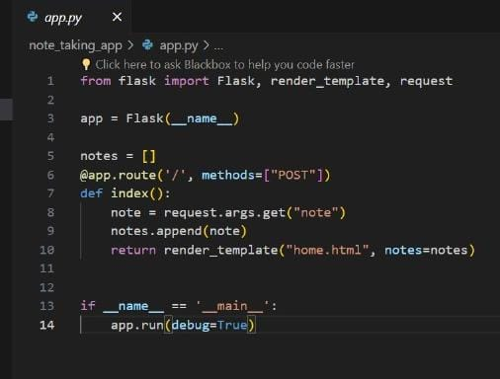
TASK:
Refactor the existing codebase and ensure the proper functioning of the Note Taking Application.Document all identified bugs during the debugging process. Remember, the task is not about recreating the app from scratch. Your goal is to fix the already existing codebase and make the application work as intended.
EXISTING CODE OF app.py:

Slide 4
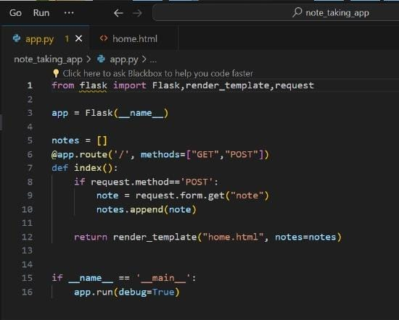
BUG FIXING IN app.py:
The method specified in the route decorator is "POST", but the request method used in the function is accessing the query parameters with request.args.get(), which is used for GET requests, not POST requests.
To fix this bug, you should use request.form.get() to access the form data for POST requests. Here's the corrected code:

Slide 5
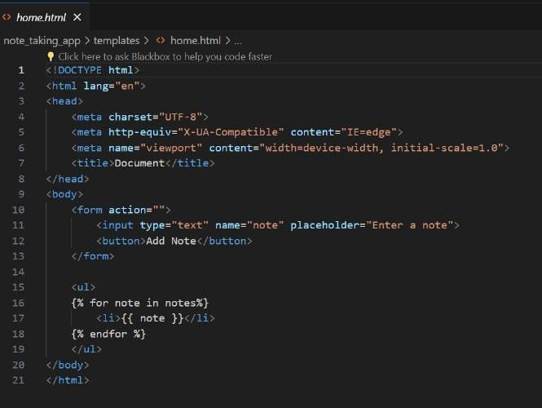
Html Code :
1.Element method is missing in the form tag
2.Type parameter is missing in button tag

Slide 6
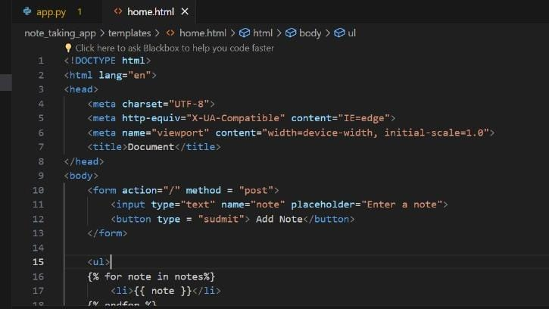
Html Bug Fixing:
1.Method = ‘POST’ in form tag
2.Type = ‘sudmit’ in button tag

Slide 7
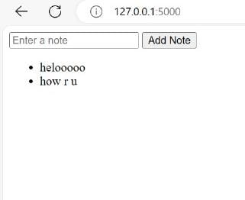
CONCLUSION:
After fixing the bugs we have sucessfully improved its functionality and usability. with these fixes tha app runs smoothly .It allows us for note taking and reviewing.

Slide 8

THANK YOU

